Slide 1


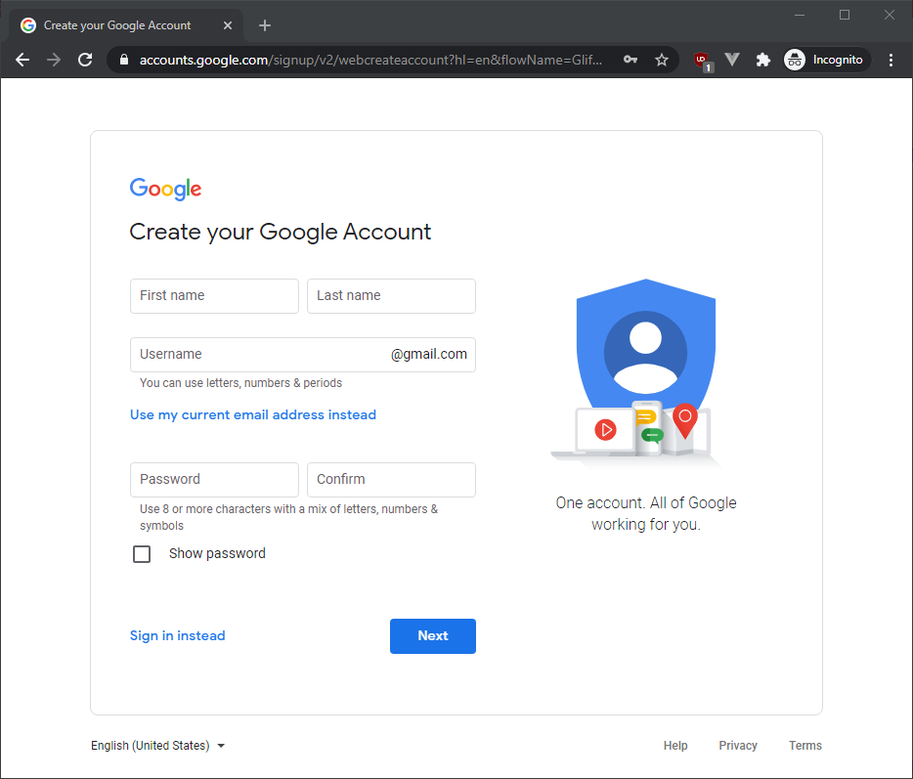
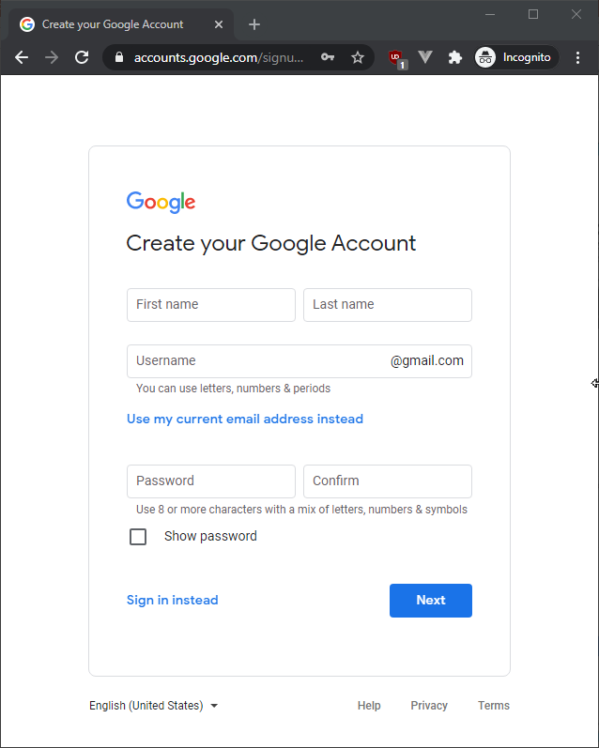
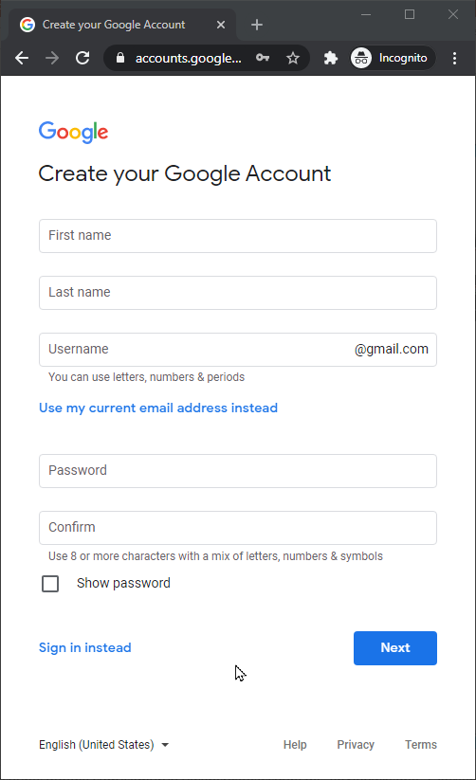
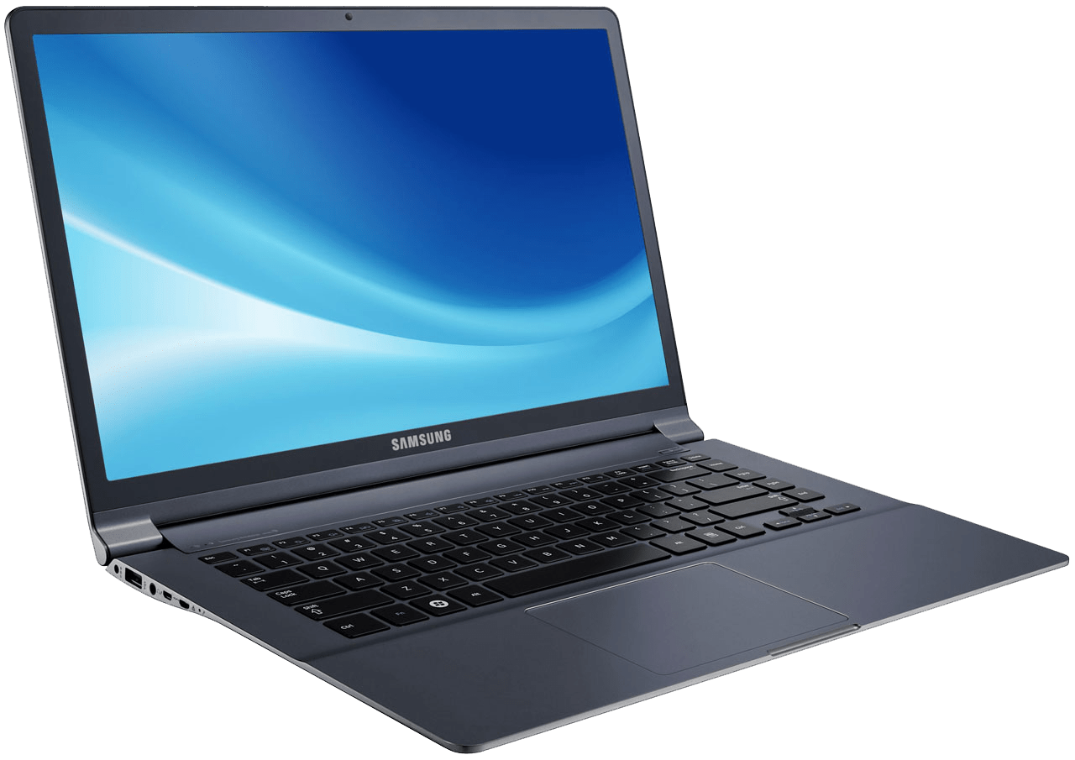
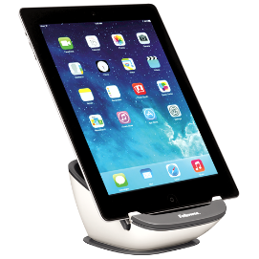

EXPLORE
List down the differences
between the different layouts
05 MIN

Slide 2
EXPLORE
List down the differences
between the different layouts
Image is hidden
First and last name on 1 colum

Slide 3



EXPLORE
List down the differences
between the different layouts

Slide 4


EXPLORE
List down the differences
between the different layouts

Slide 5
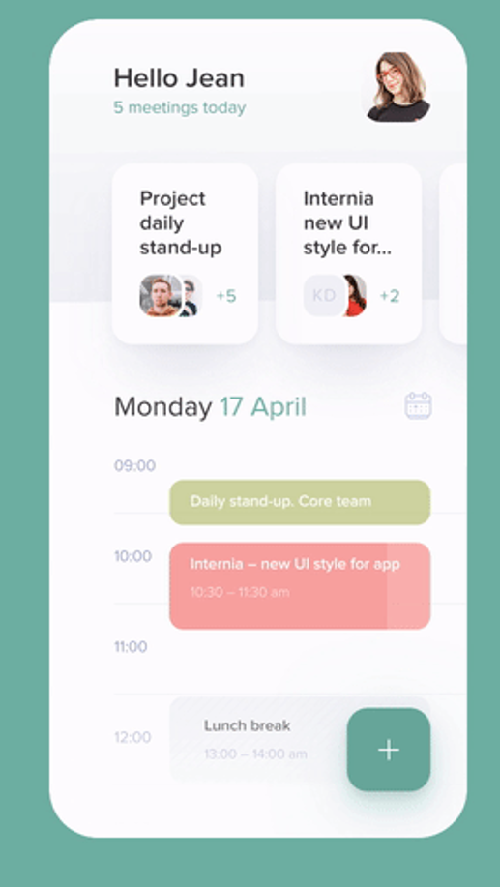

EXPLORE
List down the differences
between the different layouts

